Slide 1
PRECEDENCE NETWORK (PN)

Slide 2
Introduction
Precedence Network Analysis (PNA)
Precedence Diagramming Method (PDM) or
Activity-on-node Network.

Slide 3
In CPM/PERT networks, activities are connected according to the finish-to-start logic,
A PN incorporates the concept of delays (lags) while depicting the relationship of various start and finish activities.
The PN is best suited for planning complex construction projects.

Slide 4
Precedent Logic
Job logic
Constraints logic
Job dependency logic shows the sequence in which the jobs or activities progress
arises from the restrain on start and completion of activities imposed due to construction process at site.

Slide 5
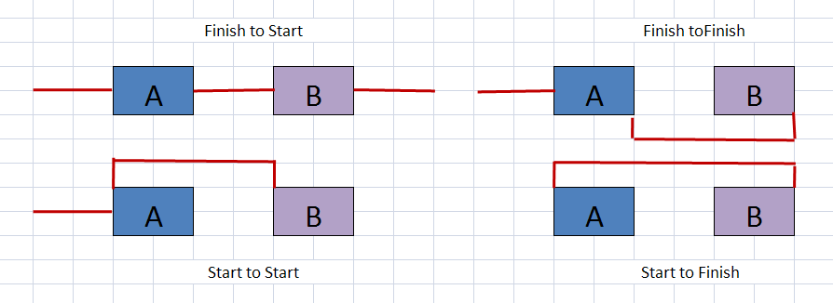
FS
FF
SS
SF

Slide 6
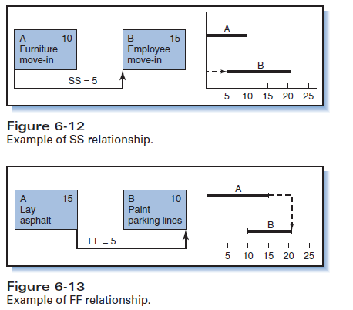

Slide 7
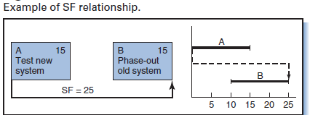
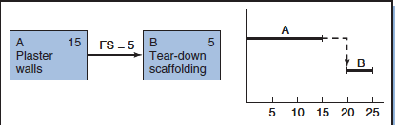

Slide 8
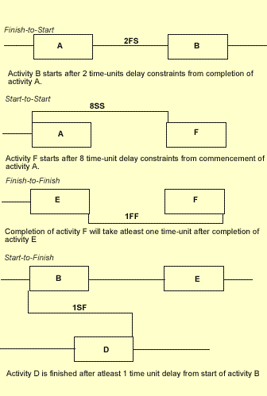

Slide 9
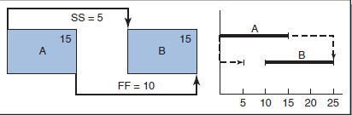
Multiple PDM relationships

Slide 10
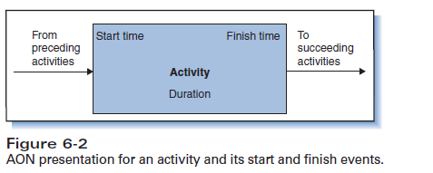

Slide 11
Example.
Code | Description | Dur
A | Excavation | 4
B | Blinding base | 2
C | Steel fabrication | 5
D | Transportation of rebar steel to site | 1
E | Formwork setting and rebar fixing Raft | 3
F | concreting | 2
PN of raft foundation The various activities involved in the raft construction are as follows:

Slide 12
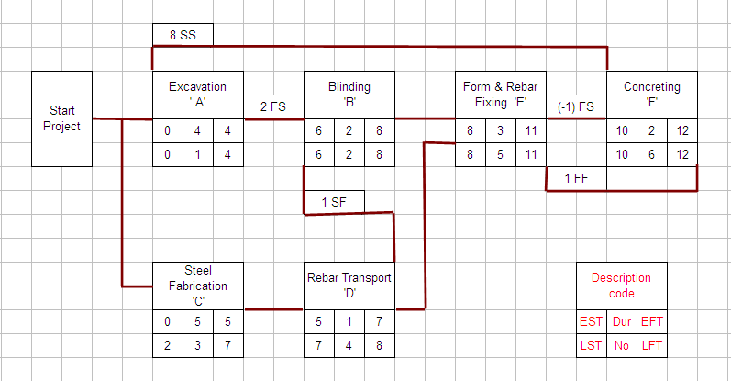

Slide 13
Forward Pass
EST of starting activity = 0
Activity A, Node – 1
EST₁ = 0
EFT₁ = EST₁ + d₁ = 0 + 4 = 4
Activity B, Node – 2
EST₂ = EFT₁ + delay = 4 + 2 = 6
EFT₂ = EST₂ + d₂ = 6 + 2 = 8

Slide 14
Activity C, Node – 3
EST₃ = 0
EFT₃ = EST₃ + d₃ = 0 + 5 = 5
Activity D, Node – 4
EST₄ = 5
EFT₄ = (EST₄ + d₄ ) or (EST₂ + 1FS) Greater one
= (5 + 1) or (6 + 1) = 7
Compute till end

Slide 15
Backward Pass
Node No. | Activity | Duration | LFT | LST
6 | F | 2 | 12 | 10
5 | E | 3 | 11 | 8
4 | D | 1 | 8 | 7
3 | C | 5 | 7 | 2
2 | B | 2 | 8 | 6
1 | A | 4 | 4 | 0

Slide 16
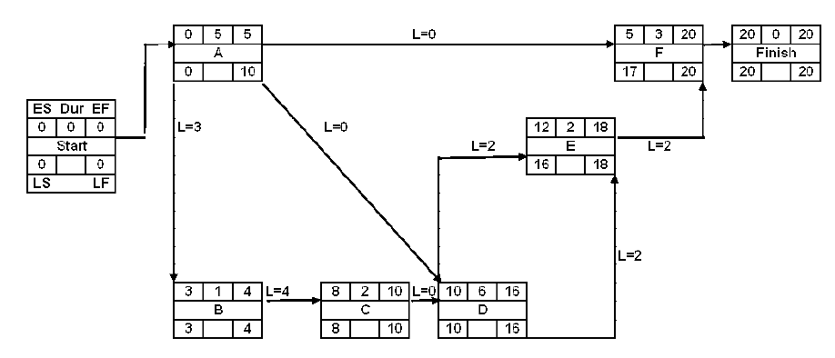

Slide 17
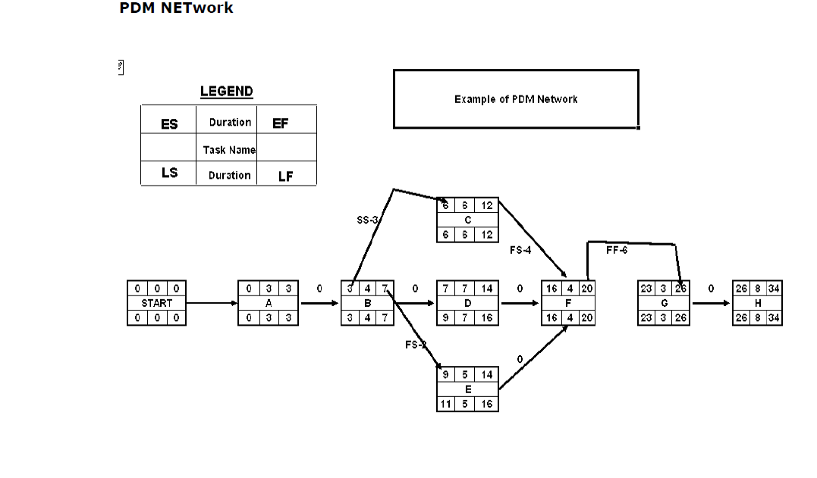

Slide 18
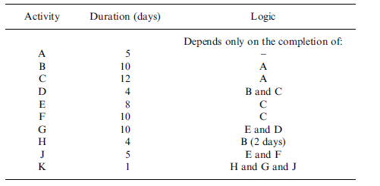
Draw a Precedence network and analyze…

Slide 19
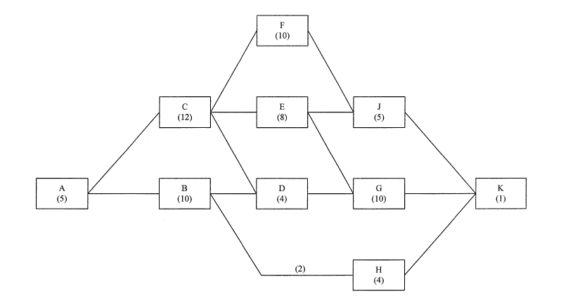

Slide 20
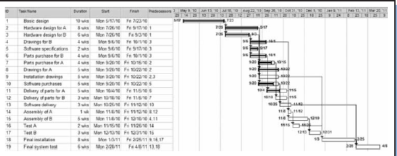
Is this a precedence network?

Slide 21
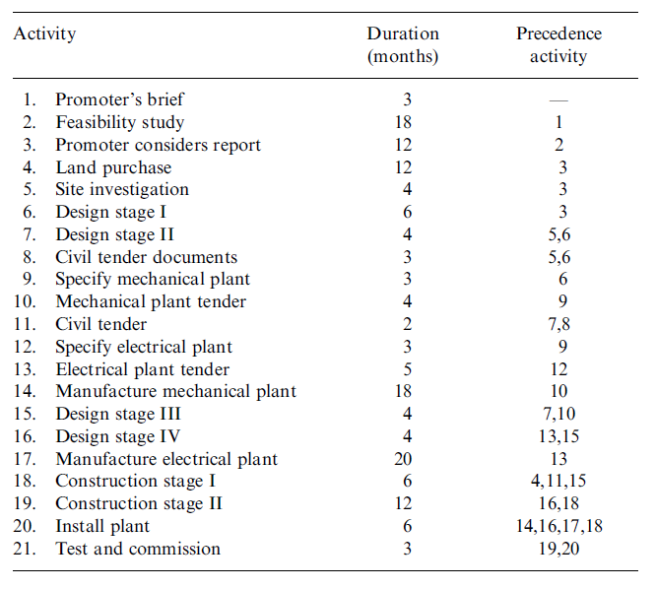
Why softwares are required? ………..to avoid tedious calculations

Slide 22
Repetitive Works Network
The PNA technique can be usefully applied to prepare the network plan of projects involving repetitive works..
Network for construction of subsequent rafts can be easily developed as follows:
Decide the order of priorities of construction of rafts.
Plan each construction activity into a work-team with the assigned manpower, equipment and other resources required for its completion.

Slide 23
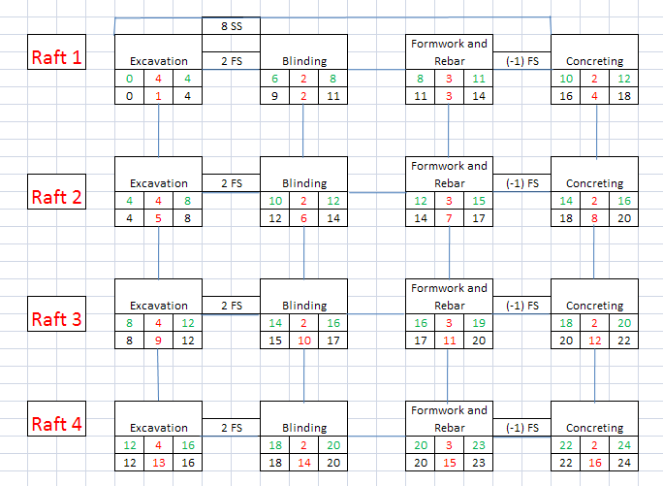

Slide 24
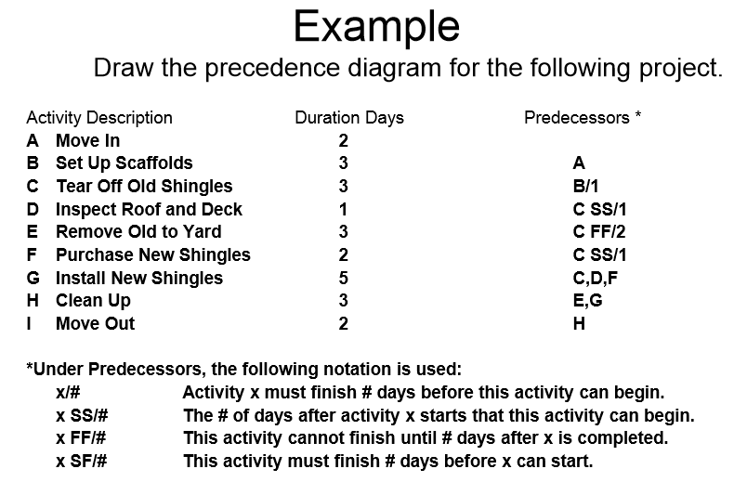

Slide 25
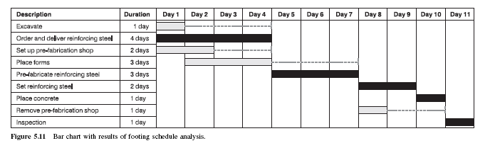
What we have learnt uptill now in Scheduling?
Network analysis
CPM
AOA
AON ( Precedence)
PERT
Resource leveling/ smoothening
Crashing CPM schedule for Cost / time optimization
Updating CPM network
…..Resource constraint scheduling
….Cost/ time optimized scheduling

Slide 26
